Slide 1

OpenAI API
Chat
Completions
One

Slide 2


Slide 3
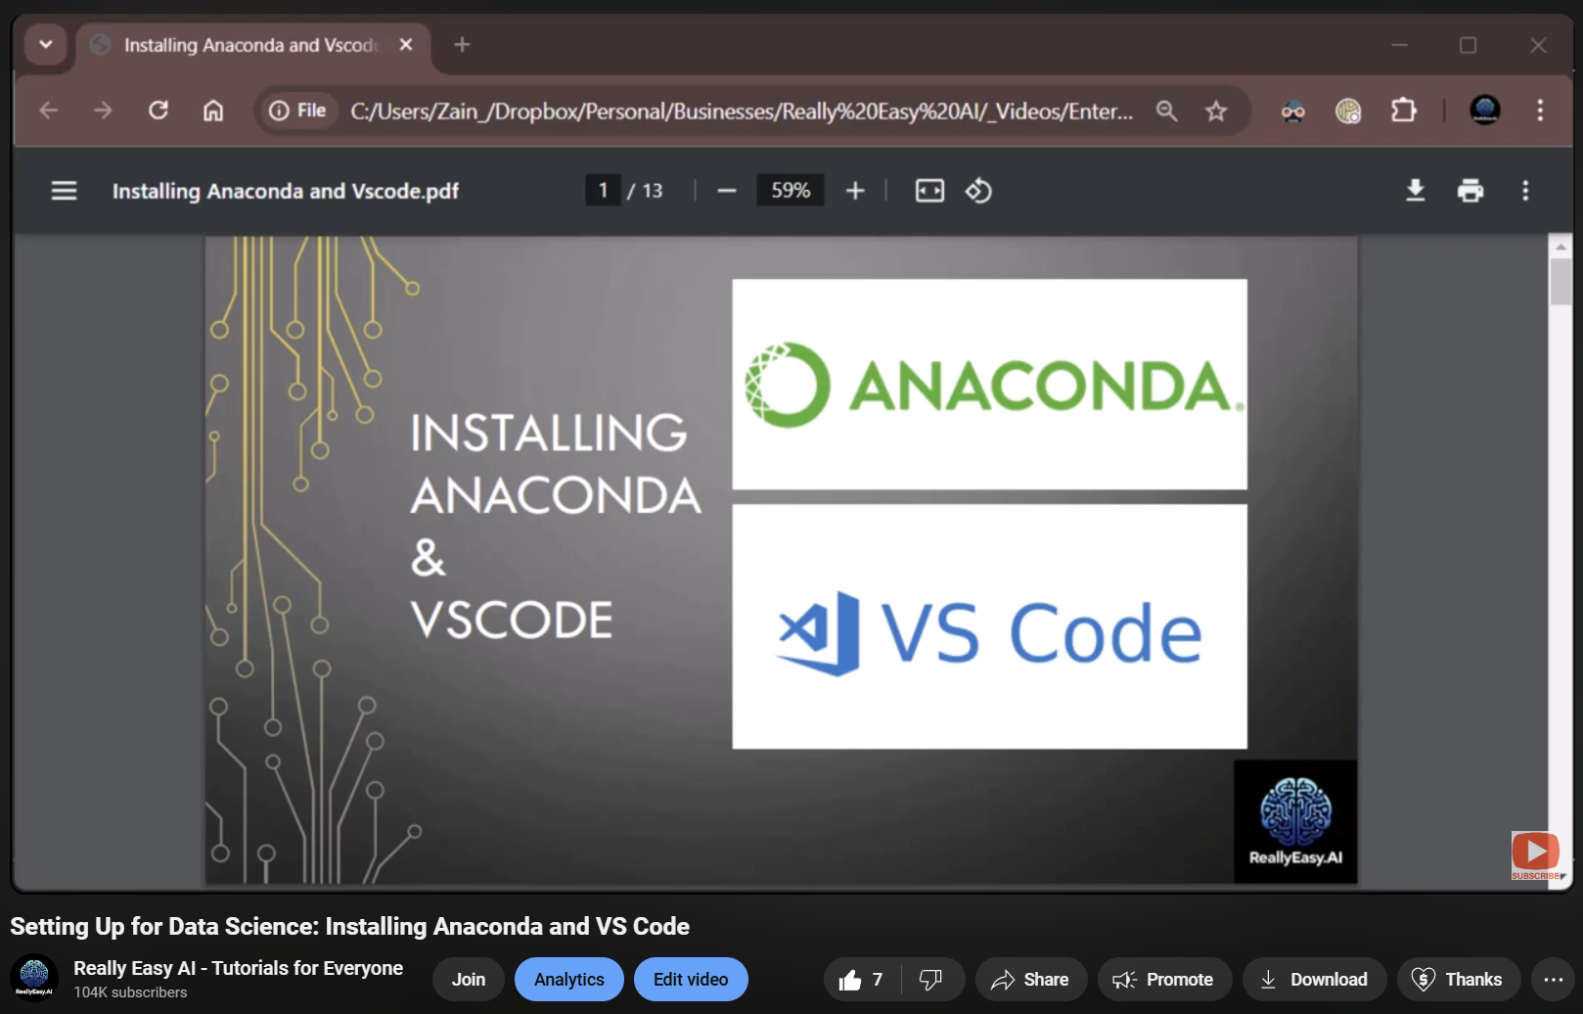
Setting up Anaconda and VS Code
Notes:
https://www.youtube.com/watch?v=50TM9pfYv5U

Slide 4
Dipping Our Toes in the Water
model
messages
response_format
temperature
stream
max_completion_tokens
stop
top_p
frequency_penalty
presence_penalty
Notes:
from openai import OpenAI
client = OpenAI()

Slide 5
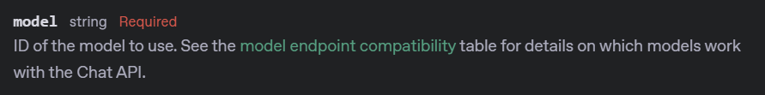
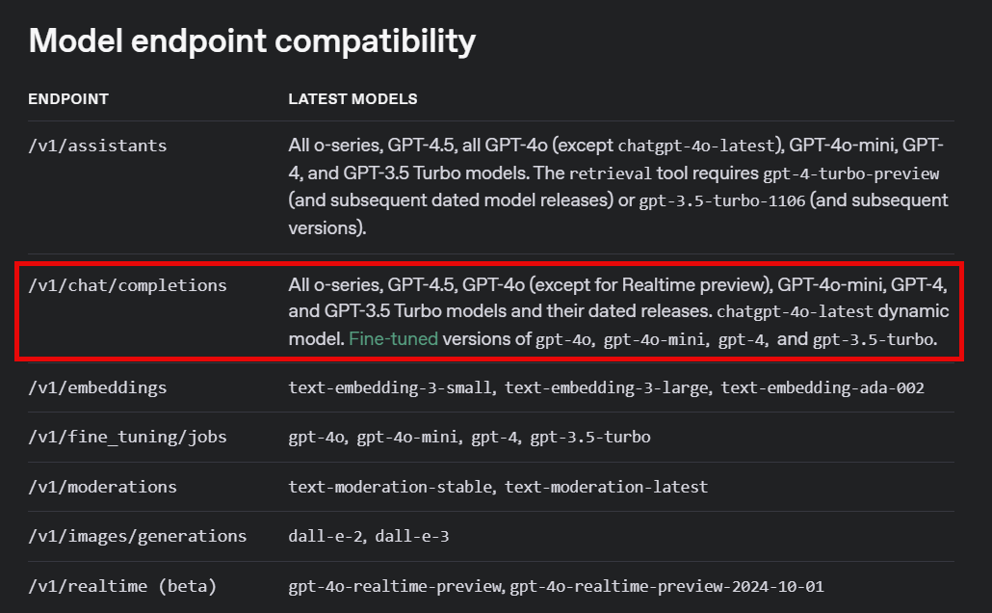
Notes:
https://platform.openai.com/docs/api-reference/chat/create#chat-create-model
https://platform.openai.com/docs/models#model-endpoint-compatibility

Slide 6
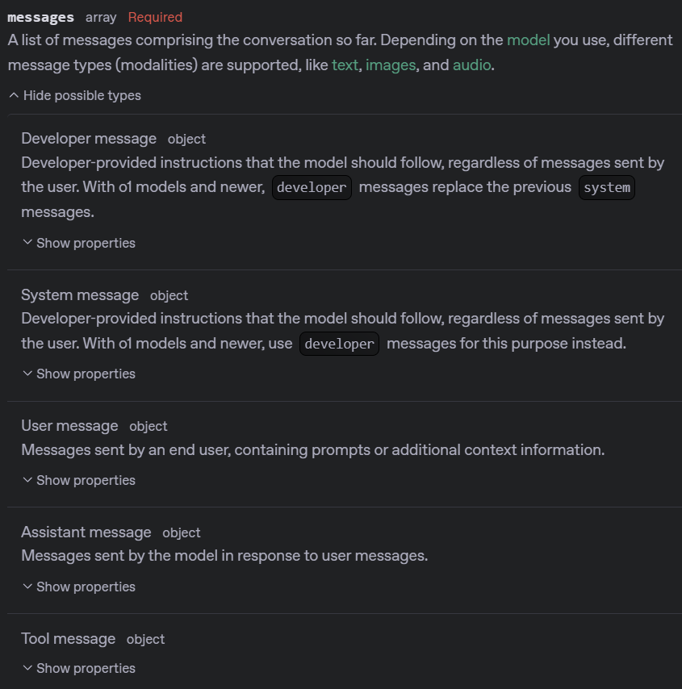
Notes:
https://platform.openai.com/docs/api-reference/chat/create#chat-create-messages
from openai import OpenAI
client = OpenAI()
completion = client.chat.completions.create(
model="gpt-4o-mini",
messages=[
{"role": "system", "content": "You are a helpful assistant."},
{
"role": "user",
"content": "Write a haiku about recursion in programming."
}
]
)
print(completion.choices[0].message.content)

Slide 7
Python Package
from openai import OpenAI
client = OpenAI()
Connection to the API

Slide 8
Variable
Connection
Endpoint
Command
completion = client.chat.completions.create(
model="gpt-4o-mini",
messages=[
{"role": "system", "content": "You are a helpful assistant."},
{"role": "user", "content": "Write a haiku about recursion in programming."}
]
)
Parameter
Argument

Slide 9
DEMO: Required Parameters

Slide 10




Notes:
https://www.youtube.com/channel/UC35ZpwldGw7ZJ5R-2sLijzw

Slide 11
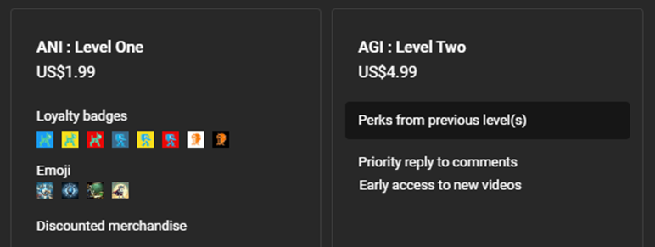
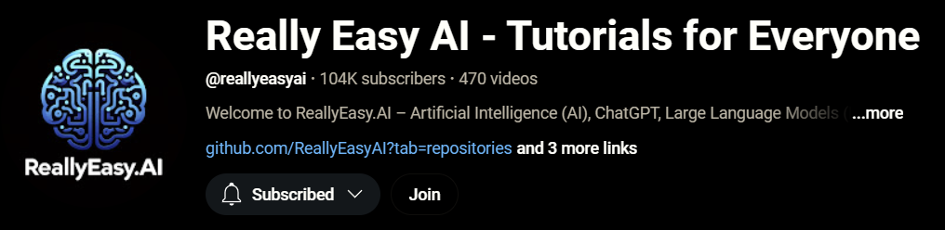
Notes:
https://www.youtube.com/@reallyeasyai/join

Slide 12

https://shop.reallyeasy.ai
Notes:
https://shop.reallyeasy.ai

Slide 13

https://www.youtube.com/@ainewsfresh
Notes:
https://www.youtube.com/@ainewsfresh

Slide 14

https://www.youtube.com/@aipaperspodcastdaily
Notes:
https://www.youtube.com/@aipaperspodcastdaily

Slide 15
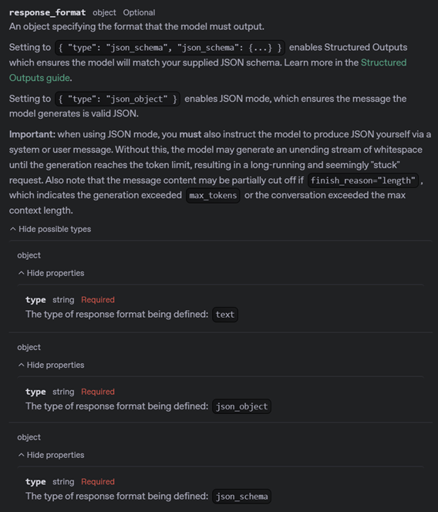
Notes:
https://platform.openai.com/docs/api-reference/chat/create#chat-create-response_format

Slide 16
completion = client.chat.completions.create(
model="gpt-4o-mini",
messages=[
{"role": "developer", "content": "You are a helpful assistant."},
{"role": "user", "content": "Write a haiku about recursion in programming."}
],
response_format={"type": "text"},
)

Slide 17
DEMO: Response Formats

Slide 18
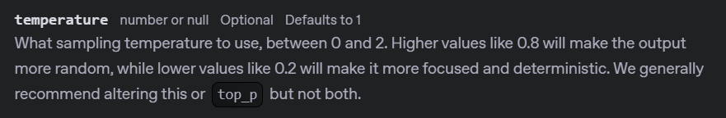
Notes:
https://platform.openai.com/docs/api-reference/chat/create#chat-create-temperature

Slide 19
completion = client.chat.completions.create(
model="gpt-4o-mini",
messages=[
{"role": "developer", "content": "You are a brilliant author of children's books."},
{"role": "user", "content": "Write two paragraphs about a frog."}
],
response_format=None,
temperature=0
)

Slide 20
DEMO: Temperature

Slide 21
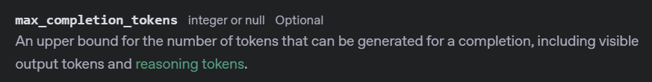
Notes:
https://platform.openai.com/docs/api-reference/chat/create#chat-create-max_completion_tokens
https://platform.openai.com/docs/models/gpt-4o-mini

Slide 22
completion = client.chat.completions.create(
model="gpt-4o-mini",
messages=[
{"role": "developer", "content": "You are a brilliant author of children's books."},
{"role": "user", "content": "Write two paragraphs about a frog."}
],
response_format=None,
temperature=None,
max_completion_tokens=1000
)

Slide 23
DEMO: Max Completion Tokens

Slide 24

Notes:
https://platform.openai.com/docs/api-reference/chat/create#chat-create-stop

Slide 25
completion = client.chat.completions.create(
model="gpt-4o-mini",
messages=[
{"role": "developer", "content": "You are a brilliant author of children's books."},
{"role": "user", "content": "Write one page about a frog."}
],
response_format=None,
temperature=None,
max_completion_tokens=None,
stop=["water","green"]
)

Slide 26
DEMO: Stop Sequences

Slide 27
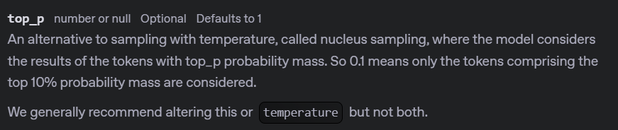
Notes:
https://platform.openai.com/docs/api-reference/chat/create#chat-create-top_p

Slide 28
completion = client.chat.completions.create(
model="gpt-4o-mini",
messages=[
{"role": "developer", "content": "You are a brilliant author of children's books."},
{"role": "user", "content": "Write two paragraphs about a frog."}
],
response_format=None,
temperature=None,
max_completion_tokens=None,
stop=None,
top_p=0.01,
)

Slide 29
DEMO: Top P (Nucleus Sampling)

Slide 30
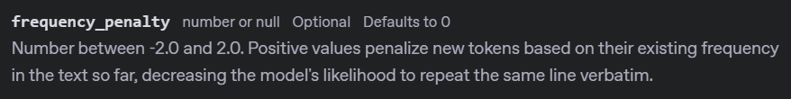
Notes:
https://platform.openai.com/docs/api-reference/chat/create#chat-create-frequency_penalty

Slide 31
completion = client.chat.completions.create(
model="gpt-4o-mini",
messages=[
{"role": "developer", "content": "You are a brilliant author of children's books."},
{"role": "user", "content": "Write two paragraphs about a frog."}
],
response_format=None,
temperature=None,
max_completion_tokens=None,
stop=None,
top_p=None,
frequency_penalty=1.5,
)

Slide 32
DEMO: Frequency Penalty

Slide 33
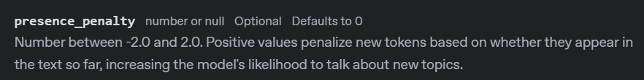
Notes:
https://platform.openai.com/docs/api-reference/chat/create#chat-create-presence_penalty

Slide 34
completion = client.chat.completions.create(
model="gpt-4o-mini",
messages=[
{"role": "developer", "content": "You are a brilliant author of children's books."},
{"role": "user", "content": "Write two paragraphs about a frog."}
],
response_format=None,
temperature=None,
max_completion_tokens=None,
stop=None,
top_p=None,
frequency_penalty=None,
presence_penalty=1.5
)

Slide 35
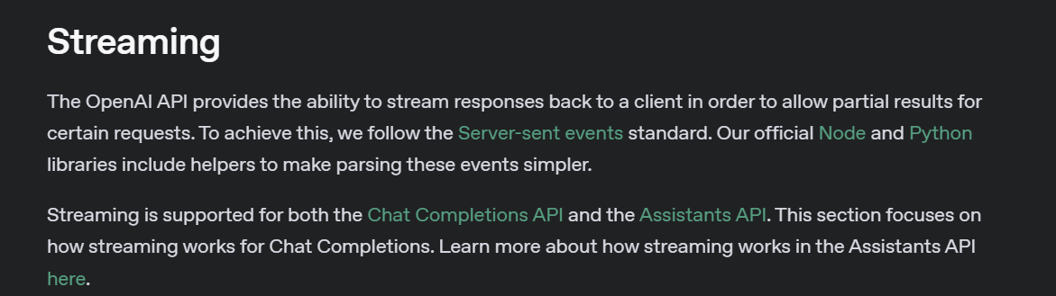
Notes:
https://platform.openai.com/docs/api-reference/streaming

Slide 36


Non-Streaming Response
How are you?
Wait for Processing
Full Response
I am great!

Slide 37
Streaming Response
How are you?
I
am
great
!

Slide 38
stream = client.chat.completions.create(
model="gpt-4o-mini",
messages=[
{"role": "developer", "content": "You are a brilliant author of children's books."},
{"role": "user", "content": "Write two paragraphs about a frog."}
],
response_format=None,
temperature=None,
max_completion_tokens=None,
stop=None,
top_p=None,
frequency_penalty=None,
presence_penalty=None,
stream=True
)

Slide 39
DEMO: Streaming Responses

Slide 40
OpenAI API
Chat
Completions
One

